Slide 1
Infection Control Protocol: Additional Measures During COVID-19
Linda Jacobson DVM
Toronto Humane Society
21 May, 2020
(feel free to use and adjust as you wish, script has also been provided for voice-over)

Slide 2
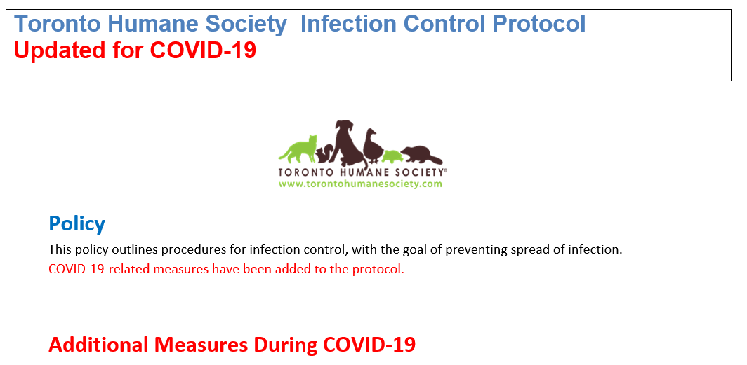

Slide 3
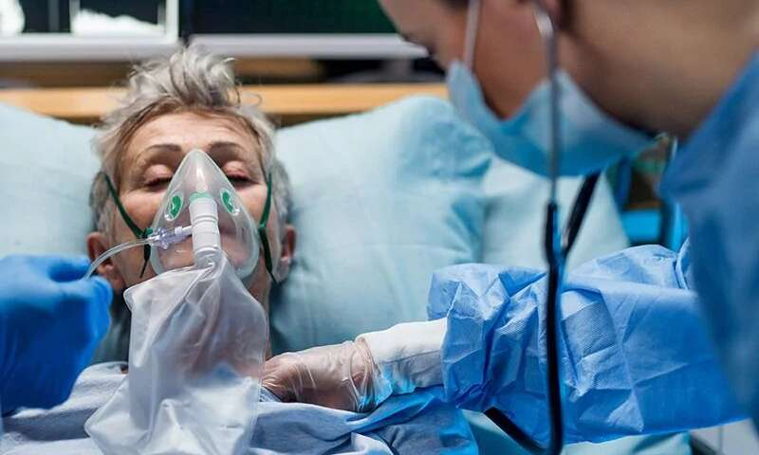
Source: Medical Xpress

Slide 4

Source: CurioCity.com

Slide 5
“Opening up does not mean the outbreak is winding down. It means there is space for you in the ICU.” Dr. Scott Weese

Slide 6
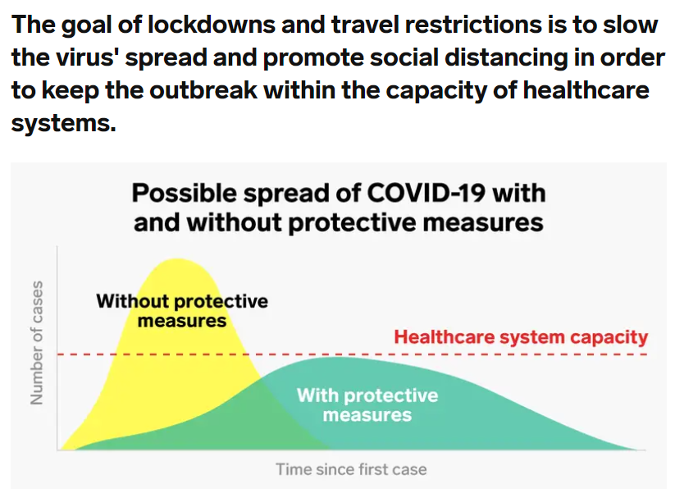

Slide 7
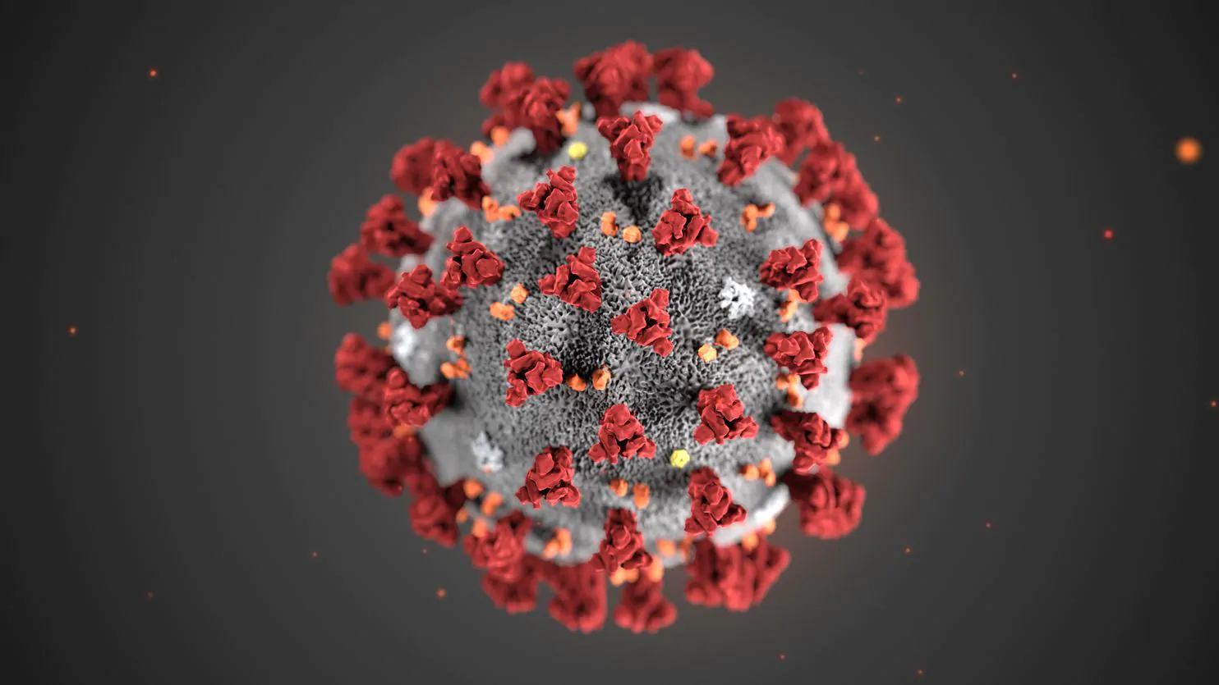
Now it’s a waiting game…
Treatment
Vaccine
Herd immunity

Slide 8

"It is so transmissible, and it is so widespread throughout the world, that even if our infections get well controlled and go down dramatically during the summer, there is virtually no chance it will be eradicated.”
– Dr. Anthony Fauci, CDC

Slide 9
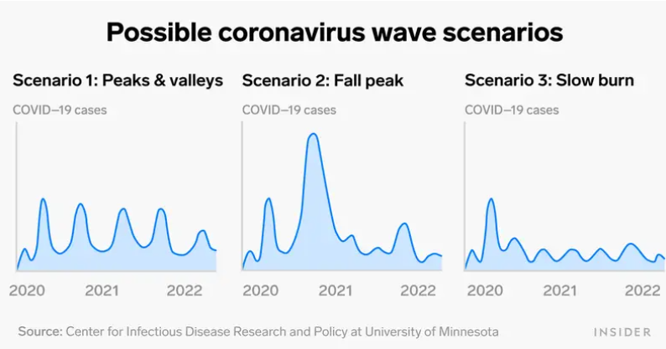
Implications for THS operations

Slide 10
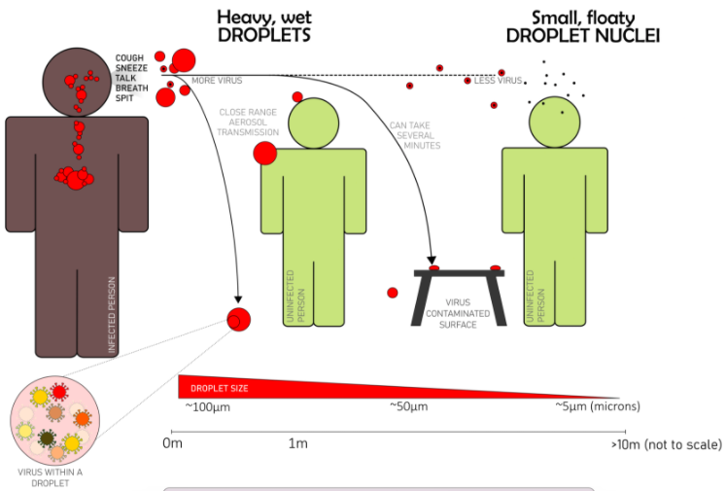
How does SARS-CoV-2 spread?
Source: Kaiserscience

Slide 11
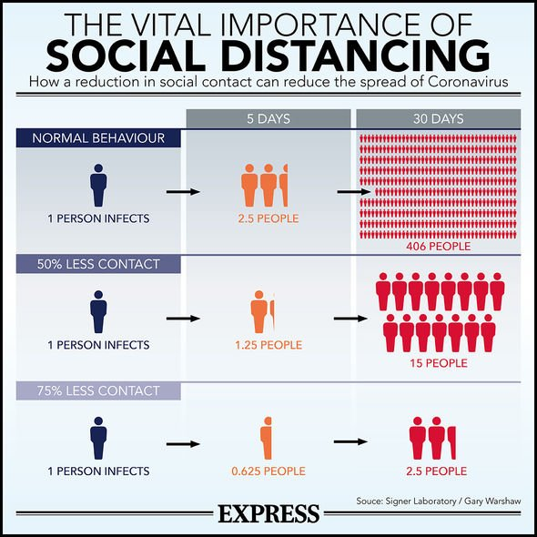
Why every individual matters
Source: Express UK

Slide 12
Can we do this?

Slide 13

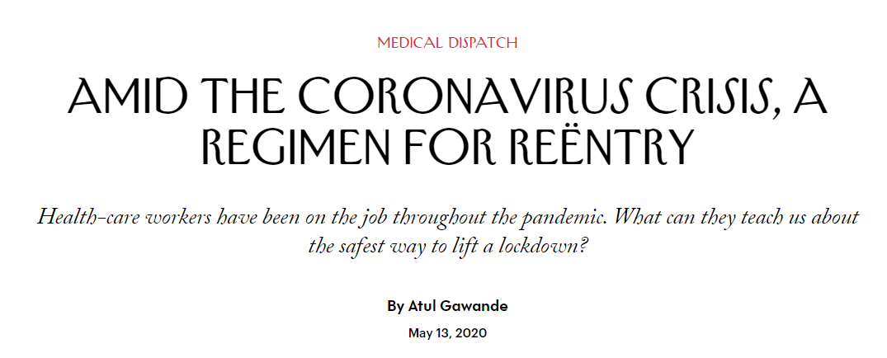

Slide 14
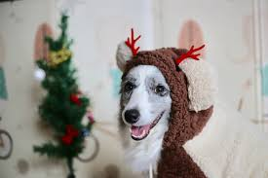
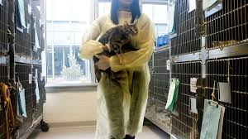
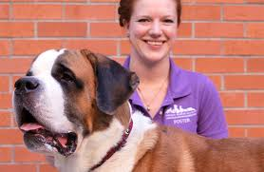
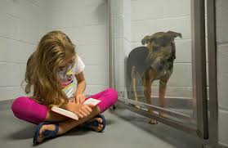
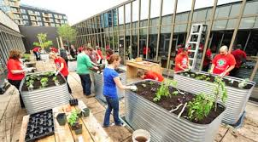
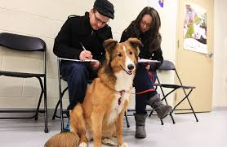
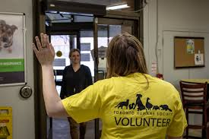


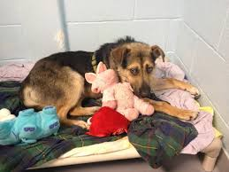
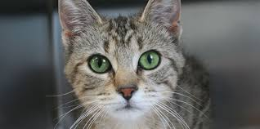
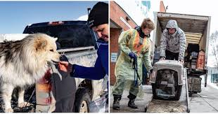

Slide 15
Preventing COVID-19
Physical distancing
Hygiene measures
Culture
Screening
Masks

Slide 16
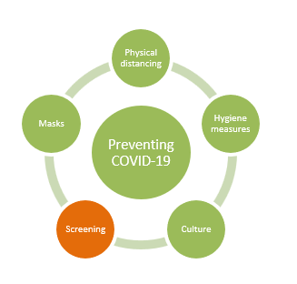
One: Screening
Screening questions help keep us safe by identifying people who may be infected with COVID-19
Everyone, every day
Self-screening is very important. Don’t come to work if you think you may have COVID-19
https://covid-19.ontario.ca/self-assessment/

Slide 17
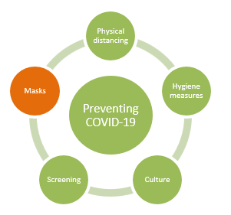
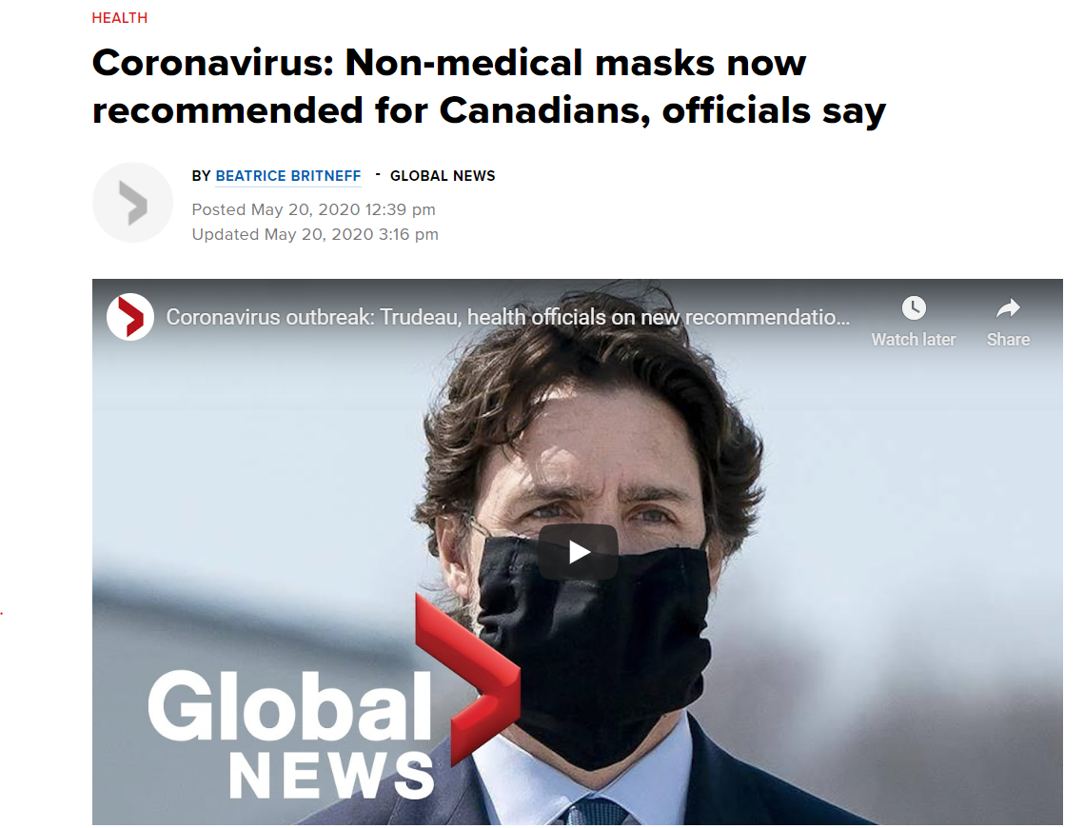
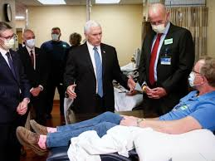
Two: Masks

Slide 18
Two: Masks
Masks help keep others safe by preventing aerosols from getting from the wearer to the other person
They also help keep the wearer safe, but are less effective for this
Masks must be worn correctly, covering the mouth and nose and fitting snugly against the face.
Everyone in the building needs to wear a mask.
Wash your mask after each workday. Normal laundry is fine.

Slide 19
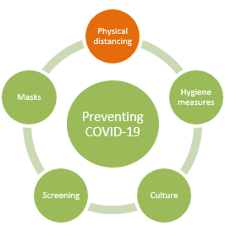
Three: Physical Distancing
Physical distancing keeps us safe by preventing virus-containing aerosols from reaching our mouth, nose and eyes
This is the single most important preventive measure
Risk of infection is lower outdoors and in large, well-ventilated spaces
The amount of time together in a confined space is very important – plan and prepare in advance!

Slide 20
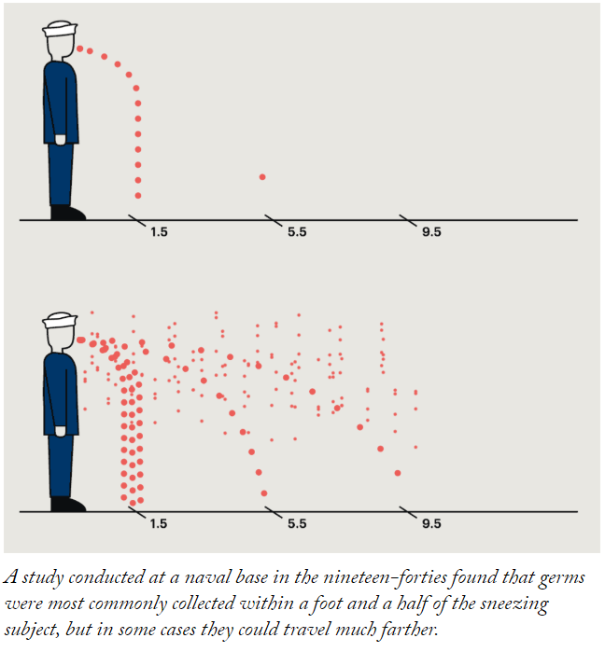

Slide 21
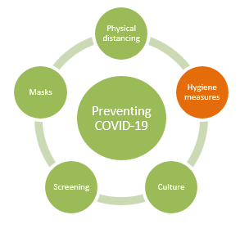

Four: Hygiene Measures
Hygiene measures keep us safe by removing virus from contaminated hands or surfaces.

Slide 22
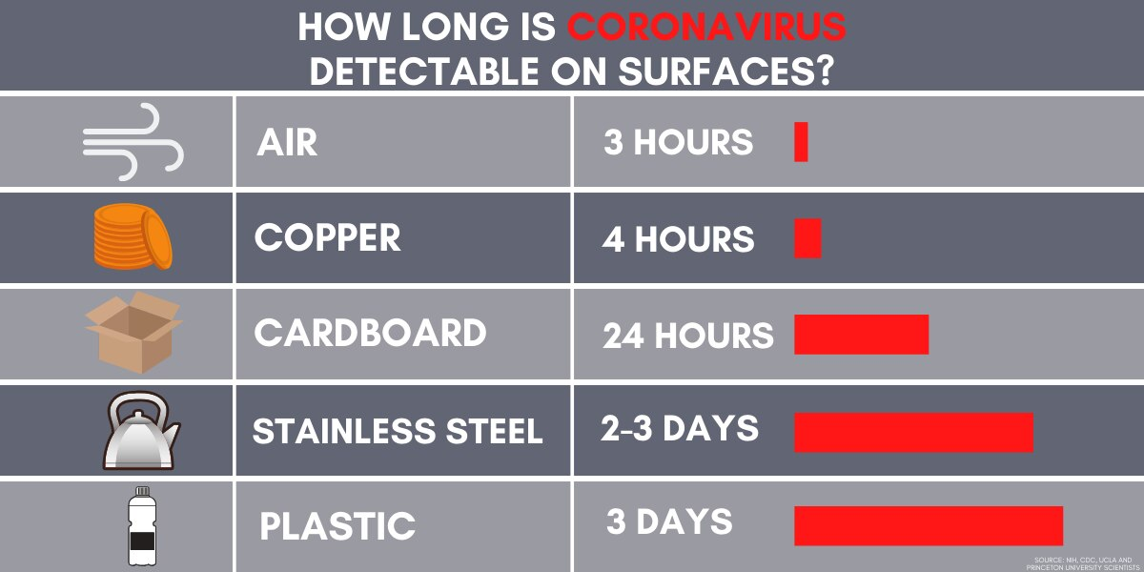
SARS-CoV-2 survival times
Adapted from Hawaii News Now

Slide 23
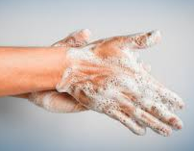
Practical Measures
Wash or sanitize hands/gloves:
  Every time you go into or out of a group environment
  Before and after handling every animal
Disinfect objects and surfaces that are frequently touched:
  Disinfection must be scheduled at the start and end of the working day, at a minimum
  During the day, pay attention to frequently touched metal and plastic objects and surfaces and disinfect these regularly.

Slide 24
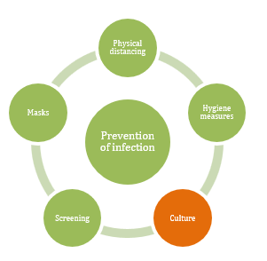
Five: Culture
Do the right thing
Be part of the solution
Practice Fearless Feedback

Slide 25
Other pieces
Conserve PPE and supplies
Putting on and taking off PPE – common sense approach:
  Don’t contaminate PPE when putting it on
  Don’t contaminate skin and clothes when taking it off
  Assume your hands are contaminated when you are done, always wash or sanitize before moving to the next task
COVID-exposed animals have their own protocol in SOPs

Slide 26
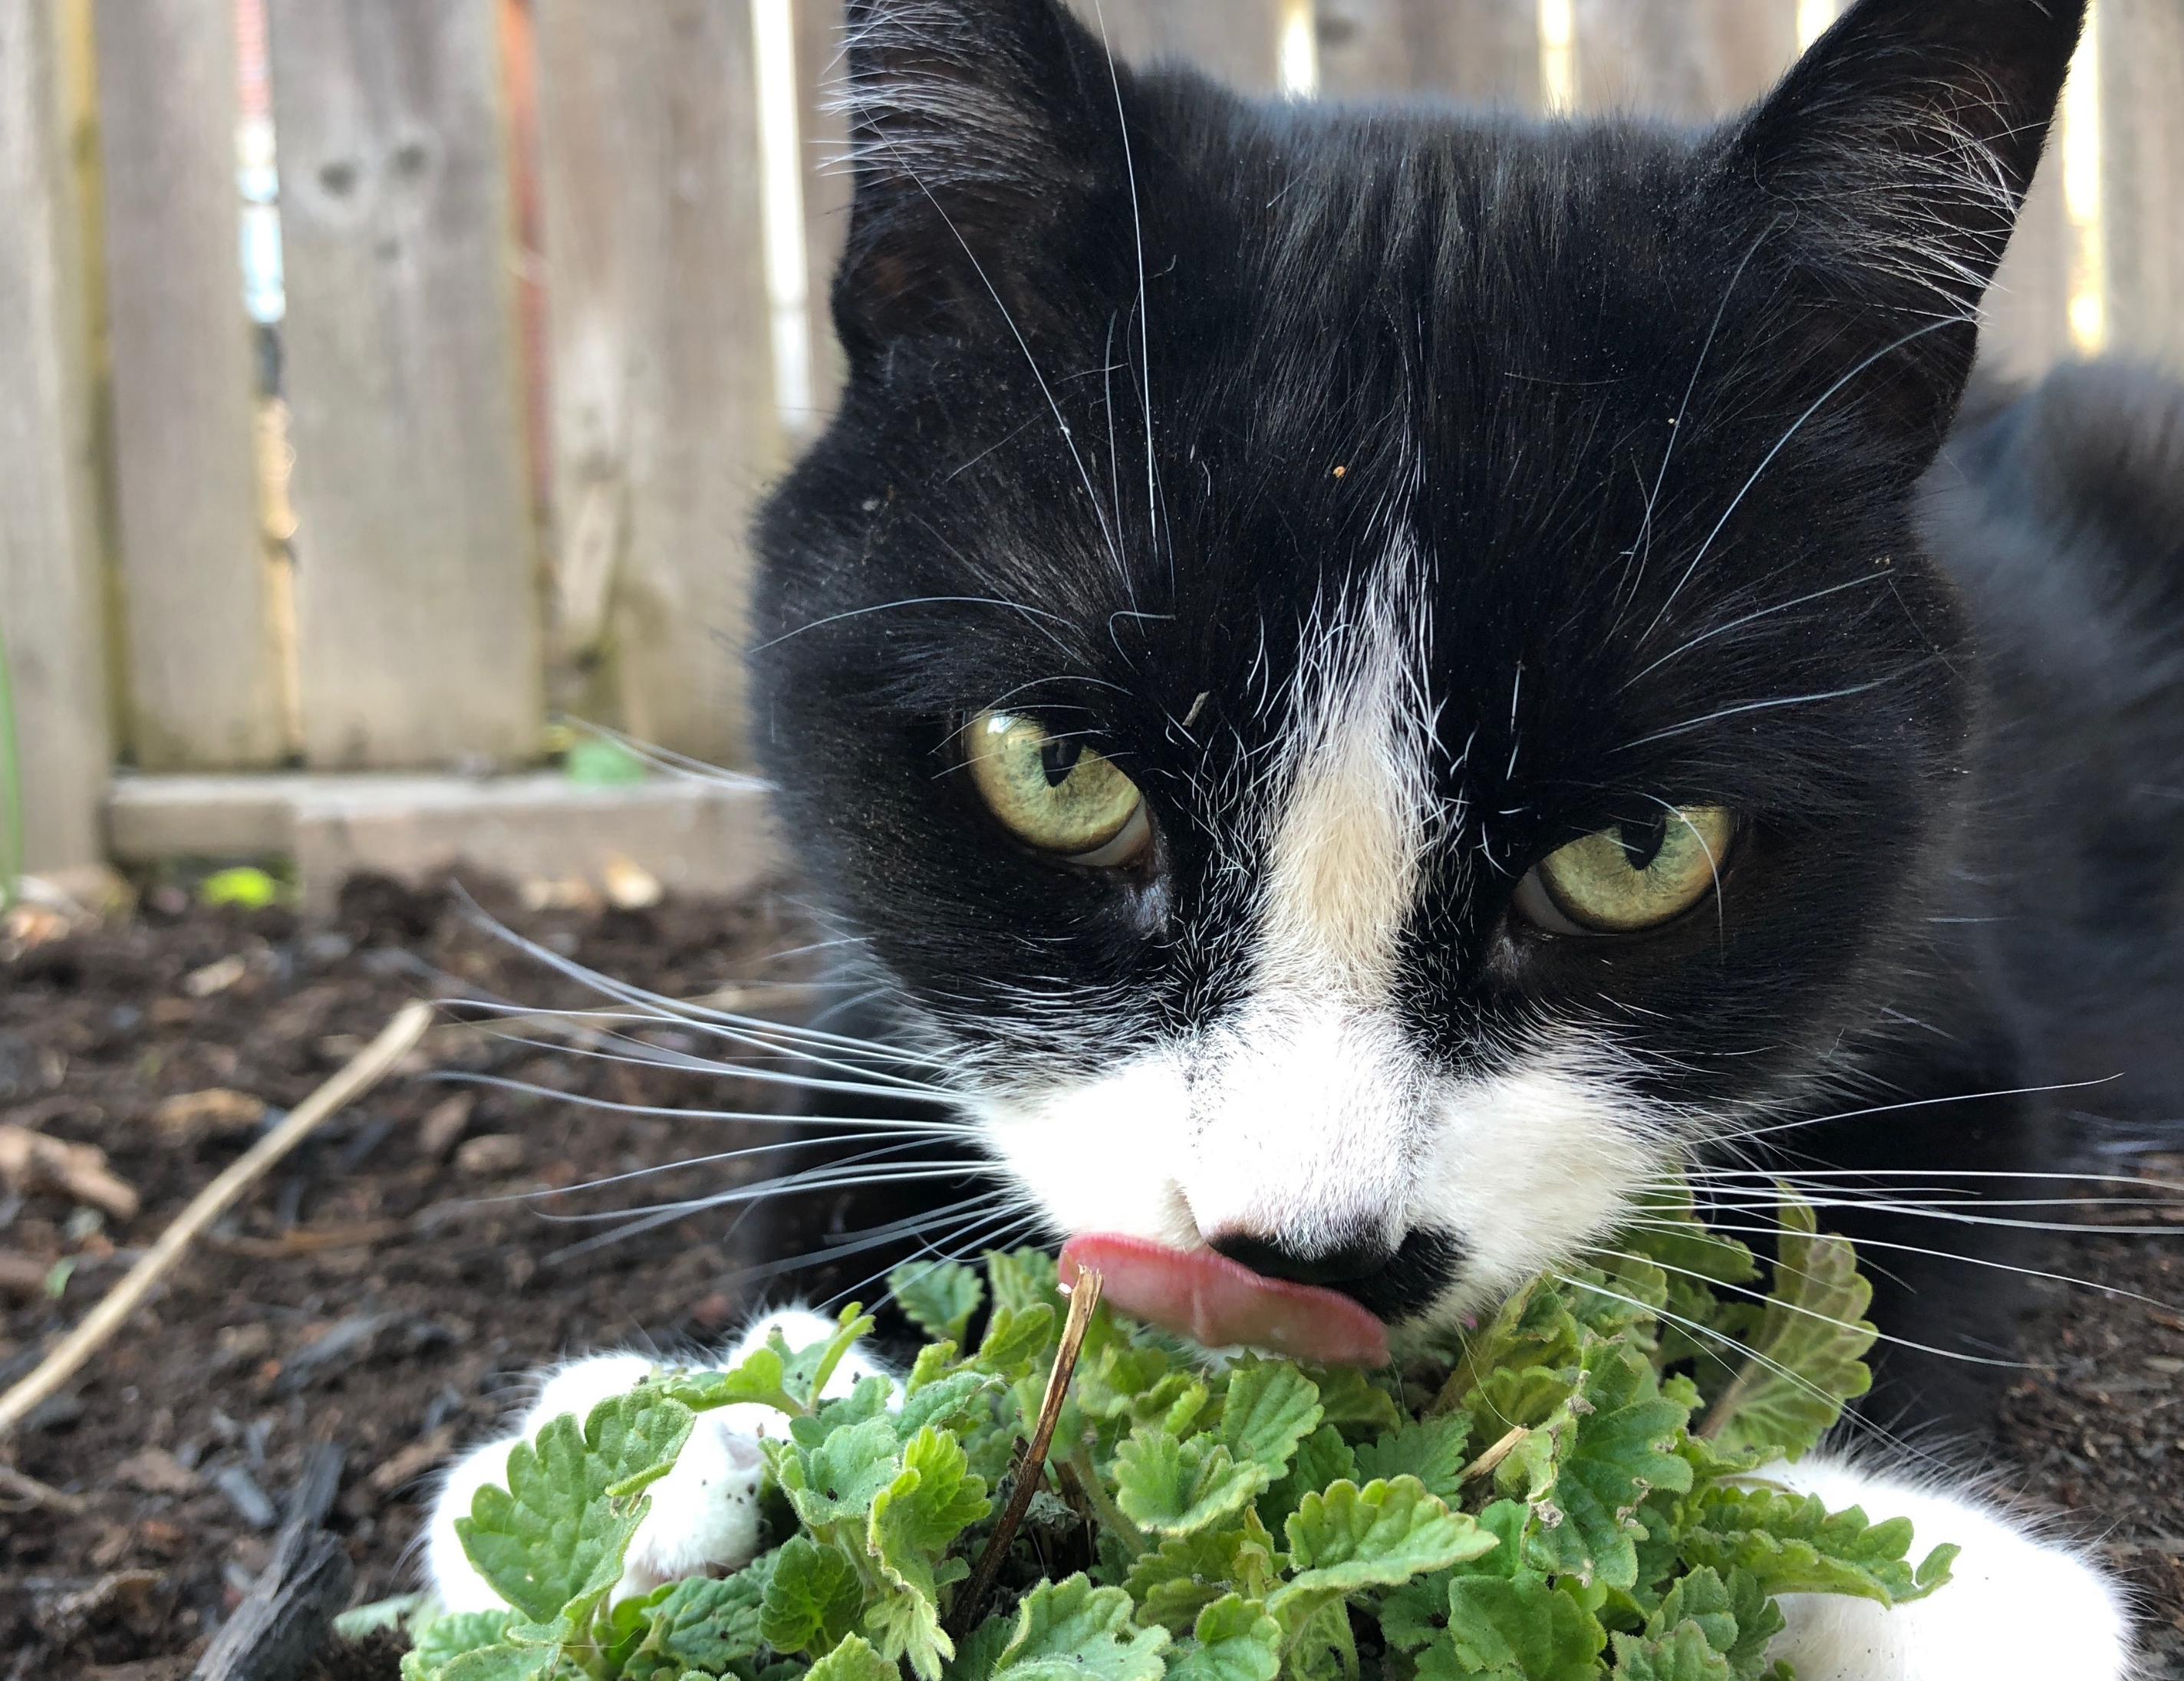
Questions?
Butler in the catnip

