Slide 1
Service Foundations
Training
Content donated by Apple Customer Service Team
August 2019
Notes:
Introduce yourselves
Have participants introduce themselves – name and position
Agenda – 3 service concepts implemented for all staff
Encourage participation
Explain parking lot (optional)

Slide 2


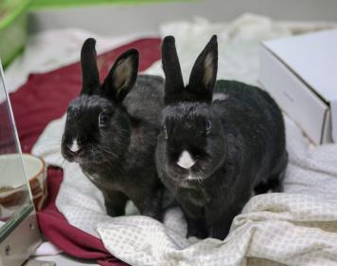
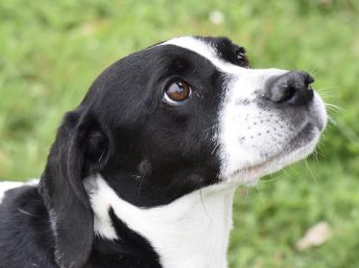

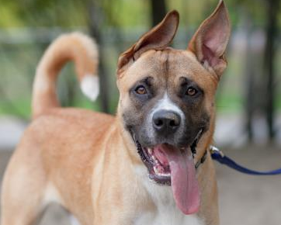
Who are we?
Why are we here?
Notes:
[These are Toronto Humane photos and are best replaced with photos from your organization]
Everyone has a part to play in client engagement and internal communication
We rely on donations from the public
It is imperative that anyone interacting with this organization has a positive experience
This training exists to strengthen your client and peer relations skill sets
Some of this might be familiar to you, and some of it might be completely new
Approach with an open-mind and an excitement to participate.
The animals are why we’re here

Slide 3
Through every interaction, [ORG NAME] strives to strengthen the human-animal bond and create allies in the community - individuals who advocate for animal welfare and [ORG NAME] mission
This is accomplished by treating every individual who engages with [ORG NAME] with a welcoming, compassionate, and empathetic approach
It is through these actions, that [ORG NAME] will lead and inspire humane action and ultimately maximize our life-saving ability
Notes:
Have 3 different participants read out one paragraph each.
Employees/Volunteers goals are the same regardless of position
We rely on donations and the good will of the community to raise money
find homes for the animal in our care
attract volunteers and foster parents
It’s vital that every visitor to the Shelter leaves with a positive experience

Slide 4
Activity
Communicating with others
Notes:
Despite positive intention, communication can become convoluted and create misunderstanding.
Activity – Broken Telephone Game
I’m going to whisper a statement into the ear of one person.
That person will whisper the same statement to the next person and so on until everyone has heard the statement.
The last person to hear the statement will tell the group what the statement is.
Ensure noise in the room, encourage participants to talk amongst themselves during the activity
Statement “Where can I find Fluffy, the bronze brindle basset hound, 9 years old, with a floppy ear that came in as an owner surrender 3 days ago”
Take Up Activity
Have last person in the chain state what they heard
Illustrate that messages can be convoluted and become mixed up both internally and with clients
Similar experience to how a customer or client in an unfamiliar setting can just as easily get lost in the shuffle.
Their needs might get misinterpreted or lost all together; resulting in a negative experience.
Despite positive intention, communication can become convoluted and create misunderstanding

Slide 5
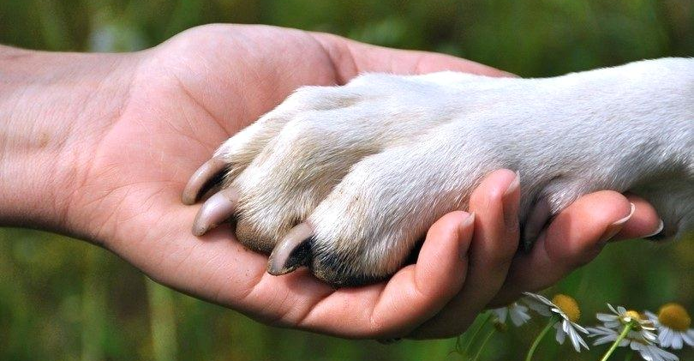
The Warm Handoff
A strategy used to minimize client disconnect throughout their journey or service process
Involves passing key information to a partner/peer with the client present in the moment so they feel cared for
Notes:
Purpose
Make clients feel welcomed, minimize confusion, and create a positive and engaged experience for everyone at the shelter
Do this with every single client, every single time
Concept
Idea is simple
If someone needs help or information that you can’t provide – help them get that support
Have you been in a store and an employee has told you “sorry that’s not my department” or “you just need to go down that way” and you end up getting lost or frustrated?
Warm hand off means listening to that person’s needs and introducing them to the correct and best resource/person to help them with those needs.
Briefly reiterate their needs to that person so client doesn’t feel as though they need to keep repeating themselves.
A few things to keep in mind:
Degree of warmth
Gradient of how warm the hand-off is dependent on staff member’s knowledge of department function, names, etc.
Be polite and happy to help that individual get the best help possible
Don’t be afraid to interrupt (politely pausing the individual let them know you’re not the right resource but will help them get there – or politely interrupting a colleague to let them know that someone is waiting for their help)
Reiterate their needs as mentioned above and introduce them by name if possible; shows you cared as you actively listened to them
What does this mean to this organization?
Consider the client experience. [Any special quirks of the organization? E.g. large, difficult to navigate?]
[If relevant - If someone pointed me in any direction, I would still feel lost]
Ask group what concerns they have about implementing the warm handoff
Offer help to everyone “Hey can I give you a hand with anything?”
Do not assume that everyone has already been helped or does not require help
“Status check” for people waiting – just get an update from the correct people on potential wait time
Barriers to the Warm Handoff
Time
Not knowing the right place
Required staff are busy with other clients
What if I don’t know the staff’s name?
Responsibility falls on you to interrupt your own conversations and touch base
Dog walking – Safety first but do the best warm hand-off you can
When do we stop what we’re doing? What is process and warm hand-off?
Can I talk about the dog as a junior staff member? The answer is YES

Slide 6

Addressing Concerns
Notes:
Intro to the 3R’s
Address the concerns of dissatisfied clients
Technique to turn frustration or misunderstanding into a positive outcome and experience
Any job involving client interaction requires addressing concerns
Also colleagues and peers, your managers, and family and friends
Important to distinguish between sympathy and empathy – empathy goes much further in improving your interactions
Short Video on the topic by Brené Brown.

Slide 7

Notes:
Play Brene Brown Video on Empathy vs. Sympathy (2 min 52 sec)
(Cut and paste into web browser if link doesn’t work)
https://www.youtube.com/watch?v=1Evwgu369Jw

Slide 8
Addressing
Concerns
Sympathy vs Empathy
Sympathy - feeling pity or sadness for someone else’s state of misfortune
Empathy - ability to understand, connect with, and share the feelings of another person
Notes:
Sympathy – Acknowledging another person’s emotional hardships and providing comfort and assurance but removed from it – you alright down there?
Empathy – Understanding what others are feeling because you have experienced it yourself or can put yourself in their shoes – climbing down to them

Slide 9
Addressing
Concerns
Qualities of Empathy
Perspective taking
Staying out of judgment
Recognizing emotion in others
Communicating that with the individual
Notes:
General Notes:
If someone has escalated or is frustrated, something led them to feel this way
Until we identify why, won’t be effective in empathetic response
Be genuine
4 Qualities of Empathy – Theresa Wiseman
Perspective taking – ability to take the perspective of others
Staying out of judgement – not easy!
Recognizing emotion in others
Communication/share the emotion

Slide 10
Addressing
Concerns
The Three R’s
Recognize
Respond Empathetically
Reassure
Notes:
BREAK INTO GROUPS OF 3
The Three R’s
Guideline to begin/continue a conversation when addressing the concerns of another individual
RECOGNIZE what individual might be experiencing as point of concern or distress.
Might be aspect of environment or situation at hand, misinterpretation, or a perception they have
Listen to what they are saying and try to empathetically understand what the concern is
RESPOND EMPATHETICALLY - either aligning with how they might be feeling, relating through a shared experience, or being completely truthful if this is new to you and you can’t begin to imagine what they are going through
REASSURE the individual there is some form a solution or answer.
Does not always mean will be the perfect or most desired answer
Genuinely show that you are doing everything you can to help in the most appropriate manner – this is what matters.
BE GENUINE
Example - individual missed out on a dog they wanted to adopt

Slide 11
Addressing
Concerns
The Three R’s
Example
I understand you were so excited to adopt and I’m sorry that the dog you wanted is no longer available
I remember when I first started the adoption process for my dog and how excited - and truthfully, a bit stressed - I was about it too. It’s a big decision!
While it might not have worked out this time, we have many other dogs looking for a home and I’m sure there’s one out there for you. I’d be happy to help you.
Recognize
Respond
empathetically
Reassure
Notes:
Missed out on a dog they wanted to adopted:
Recognize
Respond Empathetically
Reassure – (or take you to someone who can help you - warm handoff) or how about fostering a puppy
Too easy to jump to excuses or solutions – important to connect first

Slide 12
Addressing
Concerns
~ Recognize
~ Respond Empathetically
~ Reassure
The Three R’s
Activity
“I feel like I’ve been waiting over an hour to get some help around here!”
Notes:
Activity
In groups of 3:
Client to read out the complaint and expand on it if moved to do so
Employee will respond using 3 R’s
Observer will provide feedback to Employee on their use of the 3 R’s
5 minutes for 1st example (Note: remember to walk amongst the groups)
Take up with whole group
How did that feel for the people who were the Employees?
Does anyone want to share their response?
Possible Activity Example:
Recognize – That is terrible to hear you’ve been waiting for so long, that must be frustrating
Respond Empathetically – I get so annoyed when I’m waiting in line myself, especially when it doesn’t seem it’s too busy
Reassure – Let me check in with the department staff and see what the hold-up is and try to get someone to help you out

Slide 13
Addressing
Concerns
~ Recognize
~ Respond Empathetically
~ Reassure
The Three R’s
Activity
“I can't afford to pay that price for this service, why can’t you just help me for free?”
Notes:
Participants switch roles - 5 minutes for 2nd example (Note: remember to walk amongst the groups)
Take up with whole group
Does anyone want to share their response/experience?
Possible Activity Example:
Rec – Veterinary bills can be so expensive and difficult to manage, especially since these things are so unexpected
Res – I know when my dog got sick, I was in a full panic on how I would be able to afford the care for him
Rea – While we can’t provide care for free as we have a lot of homeless pets to help, we’ll do everything we can to work with you on a fair price for services and get your pup feeling better
Avoid solution-oriented focus - May seem easier to solve problem - doesn’t always satisfy upset client who wants to be heard.
Take time to engage and empathize before problem solving - if go straight to payment plan or manager approved discount it doesn’t address emotions

Slide 14
Addressing
Concerns
~ Recognize
~ Respond Empathetically
~ Reassure
The Three R’s
Activity
“Why can’t I pet this dog through the bars, he’s such a sweetheart, this is crazy!”
Notes:
Participants switch roles - last example 5 minutes for 3rd example (Note: remember to walk amongst the groups)
Take up with whole group
Possible Activity Example:
Rec – Oh my gosh, I know! Milo is such a cutie.
Res – Working here and loving animals as I do I just want to pet all them all day long
Rea – But it’s actually very stressful for the animal having all these visitors petting them and it can also spread diseases. Let me introduce you to our awesome adoption team, they will be able to walk you through all the steps needed to meet the dogs – as a bonus, it will be in a room or outside, not just through the bars!
Discussion about not just stating the rules, exercise the 3 R’s
3 R’s vs. Informing

Slide 15
Addressing
Concerns
The Three R’s
Recognize
Respond Empathetically
Reassure
Notes:
What questions/concerns do you have?
Summarize Activity
Technique lets client be heard
Allows you to connect with client
Offers reassurance

Slide 16
Fearless Feedback
Means being open and receptive to feedback as well as assuming positive intent from others.
Is not an opportunity to assign blame or pass judgment on others for their actions.
Involves proactively making the decision to provide feedback when observing behaviours.
Notes:
Last concept to cover today – Fearless Feedback
Work as team to improve together, through honesty and genuine conversation
Key terms/phrases
Open, Receptive, Assume positive intent
Not to assign blame, pass judgement
Proactive
Timely and Specific!
Use IN THE MOMENT or as close to the time of an event or situation as possible. This focus on recency makes the feedback timely and relevant.
“Has someone ever shared feedback or a thought with you on something you did a long time ago in the past? Maybe you don’t remember it. Maybe you’re wondering why they brought this up out of the blue now. Maybe you’re wondering what they’re hoping to achieve in talking about this at this time. Or all of the above.”
In the moment or as close as possible helps us learn and grow from these circumstances.
Positive feedback will reinforce desired behaviour. Negative feedback will help us prevent repeat.
For EVERYONE.
For organization to have feedback culture must be 360 degrees in scope
All individuals should feel comfortable sharing AND receiving feedback openly from peers, volunteers, supervisors, managers, etc.
With POSITIVE INTENT
Objectively share feedback on an observation or behaviour
For that person’s development
Not to assign blame or to interpret a personal motive.
Share feedback because you care.
Accept feedback because that individual cared enough to share it to you.
This is not for bringing up various past issues or concerns.
Focus on the moment and situation at hand - how will that feedback further the growth of others and the THS?

Slide 17
Fearless
Feedback
Feedback Grid
Positive
General
Specific
Negative
Notes:
Specificity of feedback extremely important – Every time we provide feedback, it should be a specific as possible
Grid
Negative: undesired behaviour or result that has negative impact on success of others or the organization
Positive: desired behaviour or result that has positive impact on success of others or the organization
General: very simple in nature - “good job”, “thumbs up”, “not good”, etc.
Specific: very detailed description of behaviour or result and direct or perceived impact it had individual or group
Give an example of each type of feedback.
General Positive – “Good job just then”
Specific Positive – “I noticed when that client started getting frustrated and raised their voice you stayed really calm and listened to them and restated their concerns and they calmed right down. That was really well done”
General Negative – “You didn’t deal with that customer very well”
Specific Negative – “When you were talking with that client just now you cut them off mid-sentence and I saw the client bristle. The client seemed to get angrier at that point and started yelling.”
No feedback sandwiching! – Two positive feedbacks with a negative feedback sandwiched in between.

Slide 18
Fearless
Feedback
Fearless Feedback
Activity
“You noticed that your colleague was not maintaining eye contact while speaking to a client and rolled their eyes when a comment was made.”
Notes:
Activity
Have group divide into pairs – one gives specific feedback to the other
Providing negative specific feedback can be intimidating and uncomfortable at first
Get used to doing this - all parties need to keep in mind the positive intent behind this feedback
We are making each other, our team, and our shelter better!

Slide 19
Fearless
Feedback
Fearless Feedback
Activity
“While working at the desk one of the veterinary staff introduced a client to you who was looking for support. She was able to tell you their name, what they were looking for, and even happily said ‘goodbye, best of luck and I’m sure she’ll love the big open space on your farm!’.”
Notes:
Pairs to switch roles
Take Up Activity
How did that feel?
Any concerns with implementing this in real life?
Concerns
Recency - Share examples of a time when you wanted feedback, but weren’t provided it in a timely manner – “Of course I would have corrected that 3 weeks ago, I wish you told me” may be the response
Or it wasn’t timely – “Of course I would have corrected that 3 weeks ago, I wish you told me” may be the response
Timeliness - “Hey, I noticed something about your last client interaction and would like to give you some feedback, is now a good time?”
If no, “when would be a good time?”
Not well received – giving feedback with nothing but good intensions – remind person of fearless feedback initiative
Too general - Share examples of a time when you wanted feedback, but weren’t provided it specifically
Most Fearless Feedback should be peer to peer
Don’t sugar coat or sugar sandwich negative feedback, it’s confusing for the receiver
If try to soften negative feedback with positive the message gets lost or is confusing
(Give personal examples if possible)

Slide 20
Recap
The Warm Hand-Off
The Three R’s
  Recognize, Respond Empathetically, Reassure
Fearless Feedback
Notes:
Get participants to commit to:
Commit to practicing the Warm Handoff right away
Using the Three R’s this week with a client/visitor
Providing Fearless Feedback to 3 colleagues in the next 3 months
Being open to receiving Fearless Feedback

Slide 21
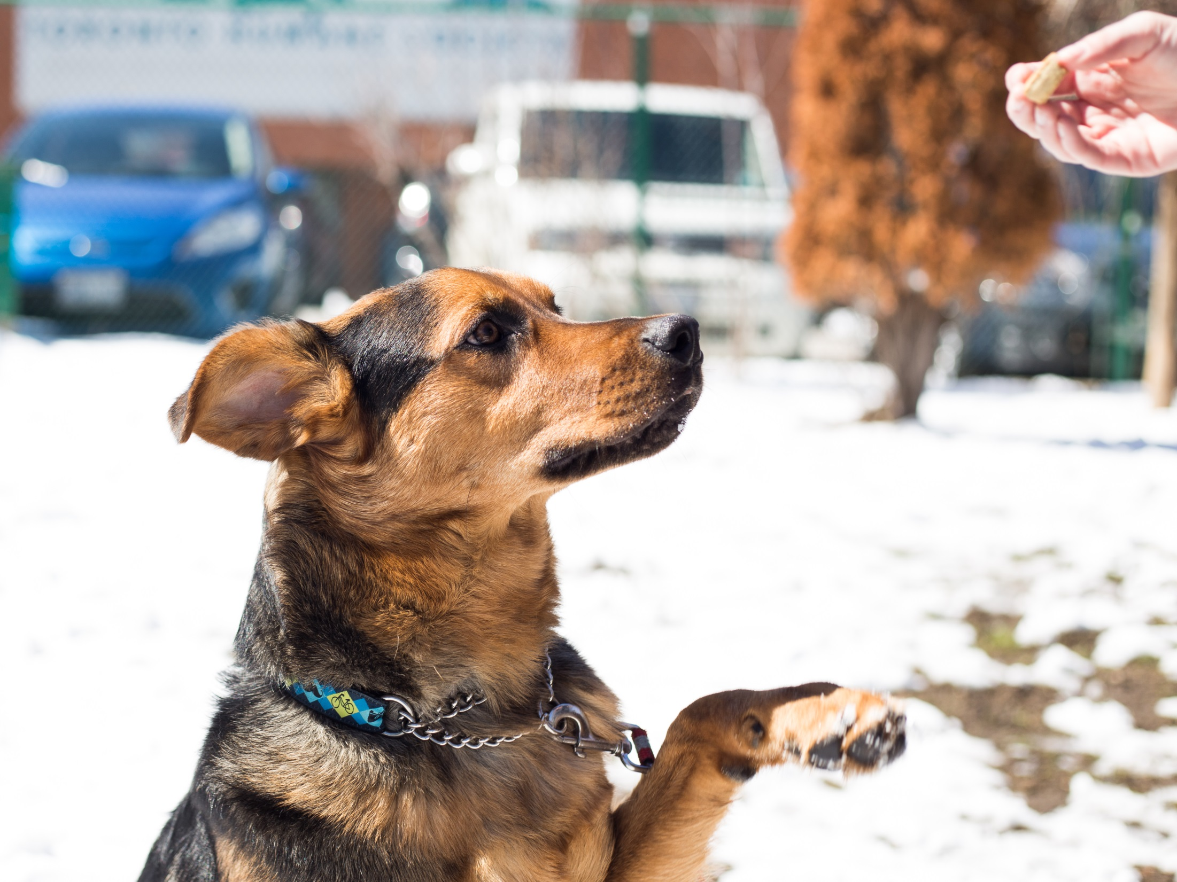
Questions?
Notes:
“Any further questions/thoughts/comments?”
Thank you

