Slide 1
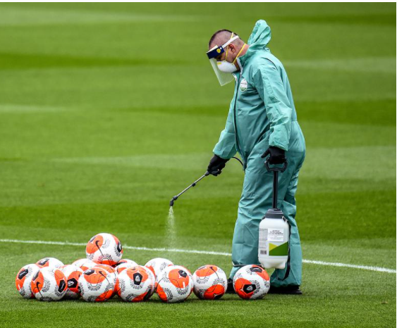

“It’s Time to Talk About COVID-19 and Surfaces Again”
Dr. Linda Jacobson DVM
Toronto Humane Society
November 2020

Slide 2
Why talk about surfaces again?
People talk and think about them a lot.
That takes the focus off strategies that are more effective at preventing infection.
Scientists don’t think surfaces are a major source of COVID-19 infection. Here’s why…

Slide 3
In the laboratory
Huge amounts of virus
Selected growth media
Selected surfaces
Controlled light, temperature, humidity
No information about how this translates into infection

Slide 4
In hospitals and institutional settings
Coronavirus is frequently found
Much smaller numbers of viruses
Varying surfaces and conditions
Die and dehydrate in saliva
No growth on culture (0/92 swabs)
Not infective

Slide 5



The road from surface to infection
Smooth
Rough, hairy
Hands
Nose, mouth, eyes
Immune system defences

Slide 6

“What, never?”
“No, never!”
“What never?”
Well… hardly ever…”

Slide 7
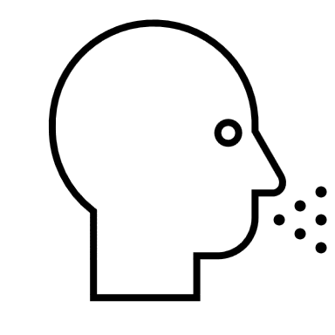
The road from the air to infection
Primary mechanism
Large droplets from an infected person
Amount of virus varies
  Coughing, sneezing >>>> singing > shouting > speaking > silent
  Mask vs no mask
  Superspreaders

Slide 8



The road from the air to infection
Major Factors:
  Distance
  Protection (masks, other barriers)
  Duration of close contact
  Ventilation
Large droplets from infected person

Slide 9
The other road from air to infection
Small “floaty” droplets accumulate
Major Factors:
  Enclosed spaces
  Poor ventilation
  Long duration
Large droplets fall to the ground

Slide 10

What about transit?
Crowding
Duration
Ventilation
Surfaces much less likely to cause infection than air

Slide 11


Whatever the surface…
No infection

Slide 12
Should…
…grocery bags be bleached? No.
…library books be quarantined? No.
…businesses refuse to take cash? No.
…kids not touch the same playground surfaces? No.
…staff and customers in non-medical settings wear gloves? No.

Slide 13
Should…
…high-touch surfaces in healthcare settings be cleaned frequently? Yes.
…we use common sense, based on knowing the risks? Yes.
…hand hygiene remain a pillar of infection control? Always!

Slide 14
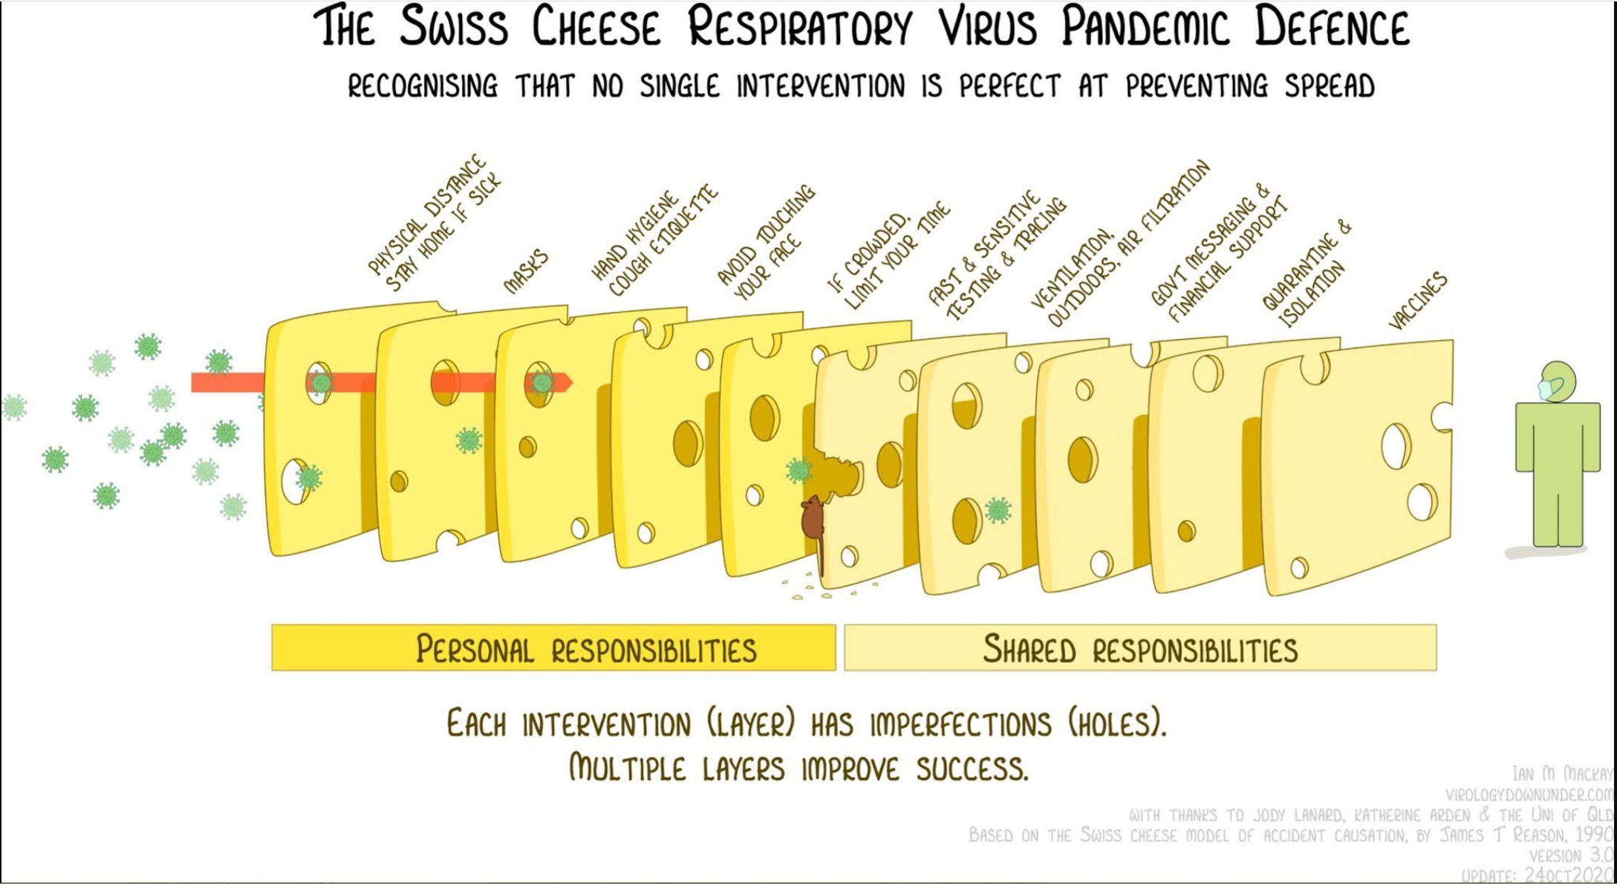

Slide 15
References
Barber G, WIRED Magazine https://www.wired.com/story/its-time-to-talk-about-covid-19-and-surfaces-again/
Goldman E, Exaggerated risk of transmission of COVID-19 by fomites
https://www.thelancet.com/journals/laninf/article/PIIS1473-3099(20)30561-2/fulltext
Ben-Shmuel B, Detection and infectivity potential of severe acute respiratory syndrome coronavirus 2 (SARS-CoV-2) environmental contamination in isolation units and quarantine facilities https://www.sciencedirect.com/science/article/pii/S1198743X20305322
Mondelli M, Low risk of SARS-CoV-2 transmission by fomites in real-life conditions https://www.thelancet.com/journals/laninf/article/PIIS1473-3099(20)30678-2/fulltext
Marr L, FAQs on Protecting Yourself from COVID-19 Aerosol Transmission
https://docs.google.com/document/d/1fB5pysccOHvxphpTmCG_TGdytavMmc1cUumn8m0pwzo/mobilebasic#h.guml01vbysm4
MacKay I, Swiss Cheese Model http://gmopundit.blogspot.com/2020/10/behold-swiss-cheese-model-30-with.html

